Slide 1



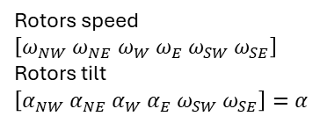

Joystick action
$${[V_{x} V_{y} V_{z} ω_{z}]}^{h}$$
Flight plan
$$xyz=f(t)$$
RemoteCommand
Navigation
Desired body kinematics
$${[u v w p q r]}^{b}$$
NeuralNetwork
Rotors speed
$$\left[ω_{NW} ω_{NE} ω_{W} ω_{E} ω_{SW} ω_{SE}\right]$$
Rotors tilt
$$\left[α_{NW} α_{NE} α_{W} α_{E} ω_{SW} ω_{SE}\right]=α$$
PlatformDynamics
Resulting body dynamics
$${[F_{xyz} T_{xyz}]}^{b}$$

